Slide 1

KENYATTA UNIVERSITY
SCHOOL OF ENGINERING AND TECHNOLOGY
DERPARTMENT OF COMPUTING & INFORMATION TECHNOLOGY
SCO400: PROJECT
Online Customizable Food Ordering System
Hassan Abdishakoor
J17/0796/2019
SUPERVISOR
Mr. Kennedy Siika

Slide 2
PROBLEM STATEMENT
The current food ordering system at restaurants fails to cater to the growing demand for transparent calorie information, leading to customer dissatisfaction and lost sales. The customers who are on a weight-loss journey will be disadvantaged and may not eat at restaurant with fear of breaking their diets. As well as the bodybuilders who require large amounts of calories to keep up with their heavy lifting sessions are most likely not eating in restaurants. Some customers who have allergies may not enjoy their favorite foods and drinks with fear of feeling unwell.

Slide 3
SOLUTION
I propose an enhanced online customizable food ordering system that provides calorie information, allows order to be put through. This system aims to meet the diverse needs of customers, attract health-conscious individuals, and bodybuilders and enhance overall customer satisfaction and loyalty. User feedback and reviews will ensure continuous improvement, ensuring a personalized and user-friendly experience for all customers.

Slide 4
PROJECT OBJECTIVES
To develop a registry module for users for them to get the services.
To develop a system that will contain information of several restaurants with their menus.
To design a system that will have a secure database that will be used to store data of users and their ordering status.
To embed a review system allowing users to provide feedback for their experiences.
To provide accurate and easily accessible calorie information for each menu item and for the users.

Slide 5
LITERATURE REVIEW
The literature review focuses on the rise of online ordering systems in the food industry, particularly the trend of customizable menus with low-calorie options. Studies highlight the potential benefits of allowing customers to customize their orders, promoting healthier choices. Challenges faced by restaurants in implementing online ordering systems are discussed, as well as factors influencing their use. Overall, configurable ordering systems offer benefits for both businesses and customers, promoting healthier choices and potentially increasing sales.

Slide 6
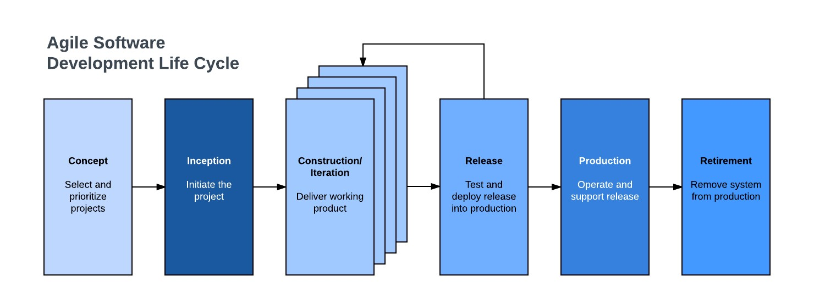
METHODOLOGY
Agile-Scrum Software Model
Agile software methodology is an iterative approach that builds software incrementally from the start of the project rather than delivering it once. Agile models allow the use of increments or possible prototypes that can evolve into a more suited and validated requirements and eventually software application. Scrum is an agile process model which follows these activities: requirements, analysis, design, evaluation and delivery. Scrum emphasizes the use of a set of software process patterns that have been proven effective for projects with tight timelines, changing requirements and business criticality.

Slide 7
SYSTEM DEVELOPMENT TOOLS
Programming languages | HTML, CSS, JAVASCRIPT AND PYTHON
DBMS | MySQL Workbench
FRAMEWORK | Django
SERVER | Django built-in Server

Slide 8
CHALLENGES
Limited availability of accurate menu information which affects the user experience and ordering process.
Limited participation of restaurants in offering customizable options.
Limited user adoption.
Challenges in accurately calculating and providing calorie information for customized food items.
Unforeseen computer breakdown that disrupted the development process.
Self Evaluation
The project was a success as all the objectives were met and I would evaluate myself as Excellent work.

